Slide 1
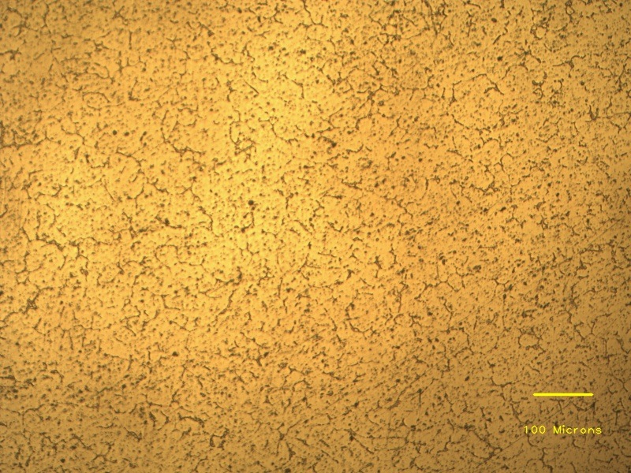
Coarse grains
Eutectic phases
Aluminium dendrites
Grain boundaries

